Slide 1
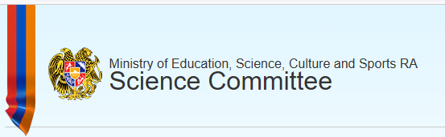
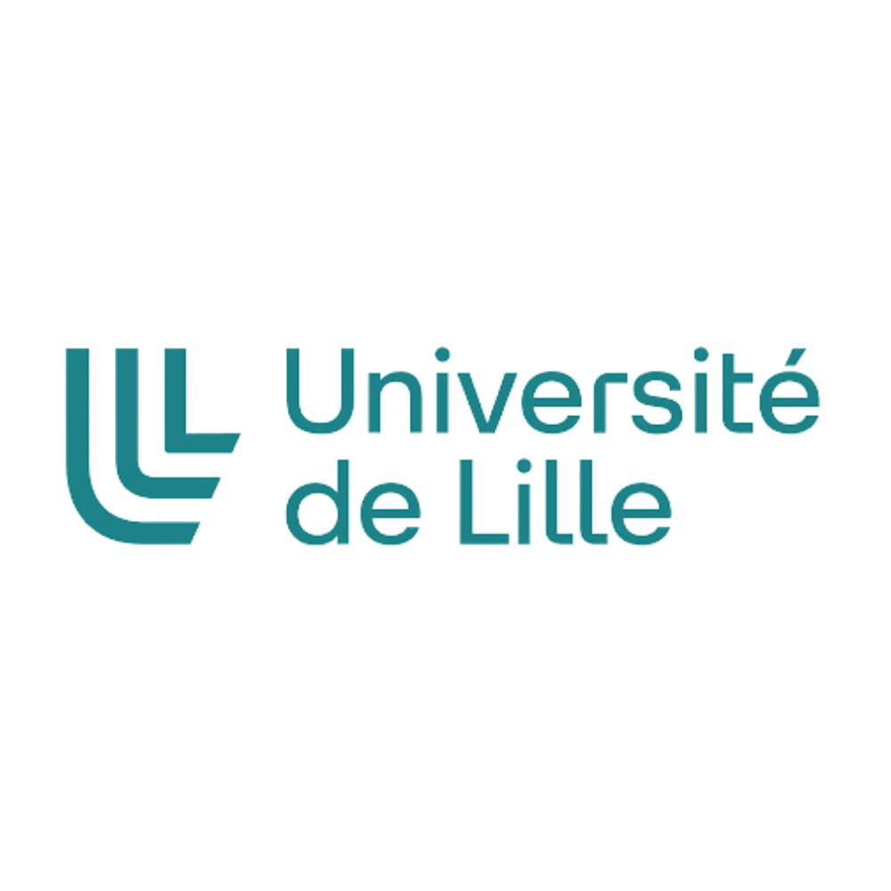

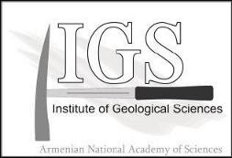




The GREATPAL Project
Deciphering the Global vs Regional record of Environmental chAnges in The PALeozoic mountains of Armenia
Rationale, Objectives, Results and Future Strategy

Slide 2

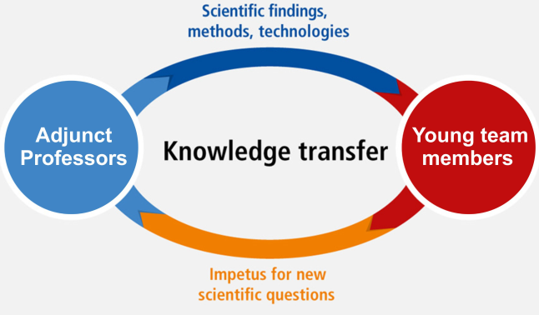
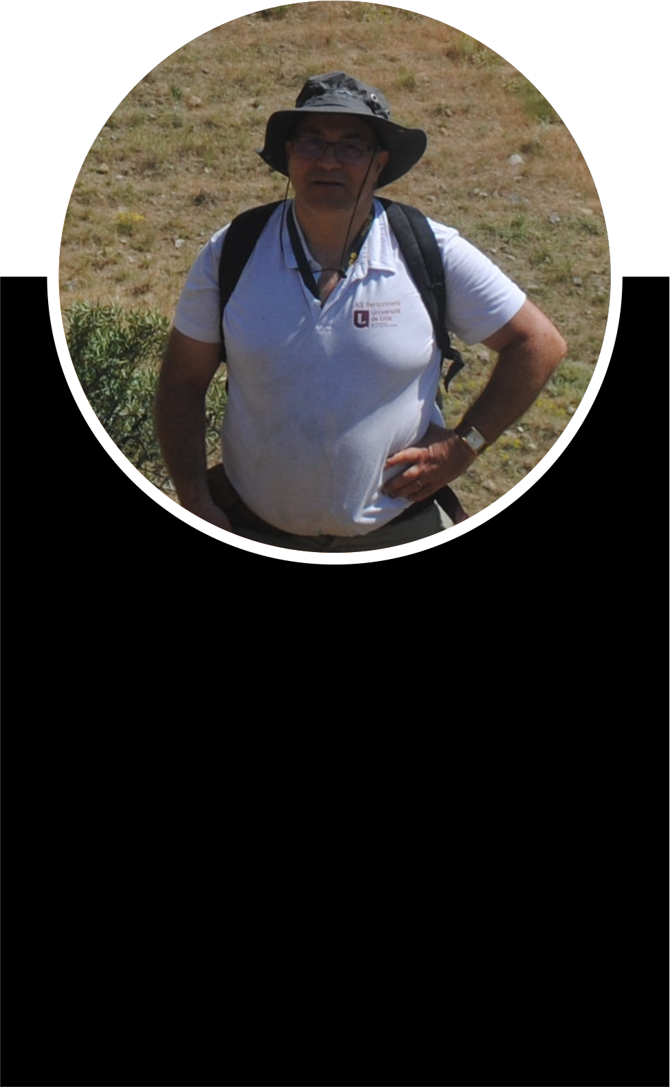

Adjunct Research Professors
Dr. Vachik Hayrapetian
(Co-PI)
Experienced on global issues
of Paleozoic Stratigraphy
Prof. Taniel Danelian (PI)
Stratigraphy, Paleobiodiversity, Paleoenvironments, Geobiology.

Slide 3
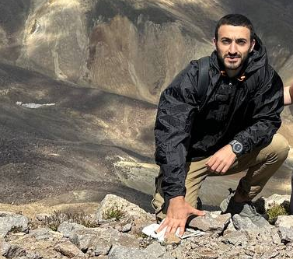
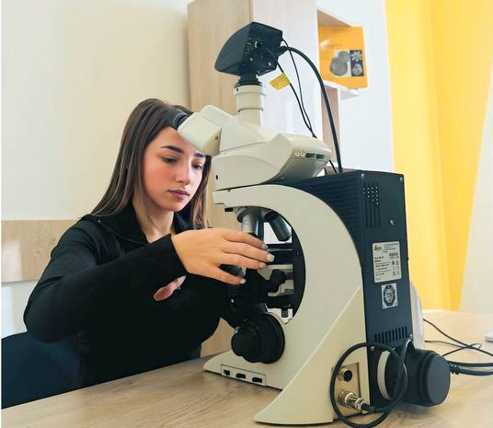
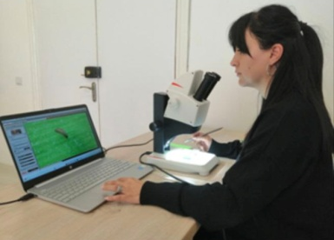
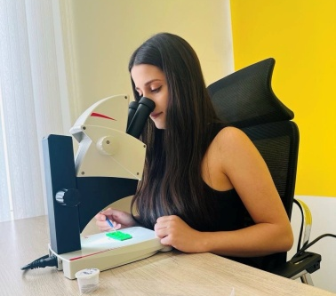
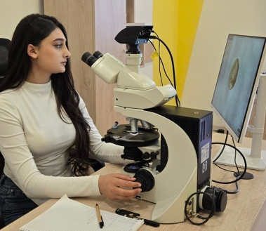
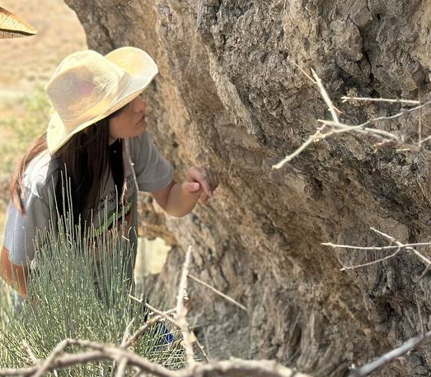
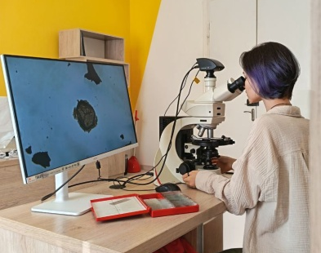
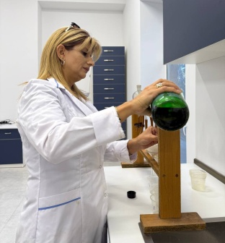
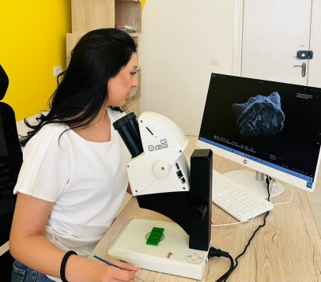
Team Members
Vahram Serobyan Double PhD degree IGS-U Lile
(Head of the lab)
Tamara Hambardzumyan 1st year PhD student in IGS
(Miospores)
Meline Tsatryan 2nd year MSc Biology, YSU
(Conodonts at F-F and D-C)
Lusine Harutyunyan 2nd year MSc Biology, YSU
(Radiolarians)
Meri Yeghiazaryan 1st year PhD student in IGS
(Acritarchs and Prasinophytes)
Gayane Kirakosyan 1st year PhD student in IGS
(Foraminifera Upper Cretaceous)
Vitalina Lokteva 2nd year MSc of Tomsk S. U.
(AI-assisted palynology)
Anna Gasparyan MSc of Biology
(Fishes at G-F and F-F)
Nune Avagyan
Long lasting experience on laboratory techniques of fossil preparations
Average age of team members
28.3

Slide 4


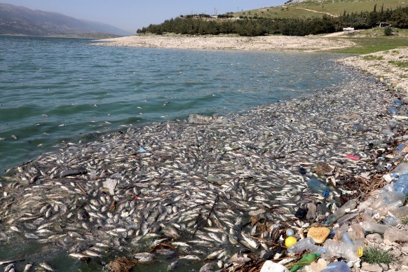
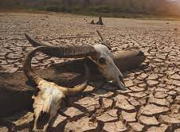
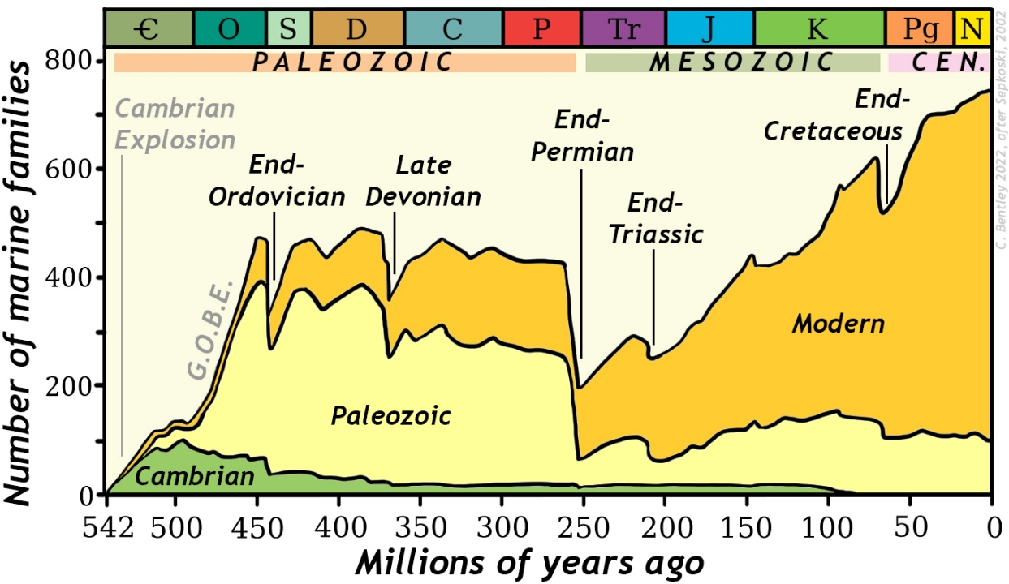
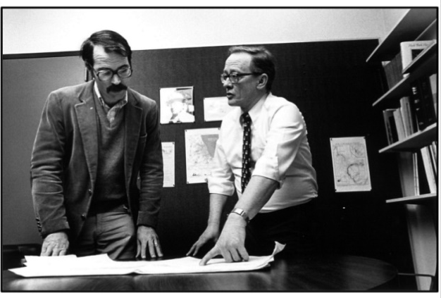
Society
relevance
Current climate change and rapid decrease of biodiversity
Using Earth’s past to understand and prepare for the future
Raup & Sepkoski 1982
The "Big Five" mass extinctions resulted in a substantial loss of biodiversity and had a profound impact on the planet's ecosystems.

Slide 5
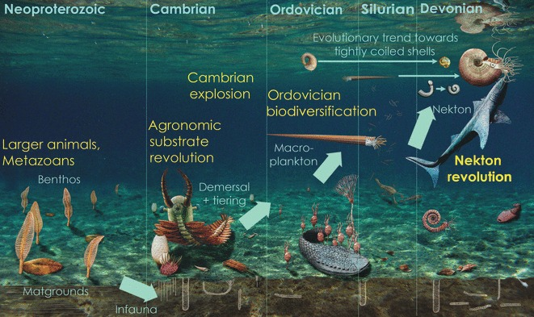
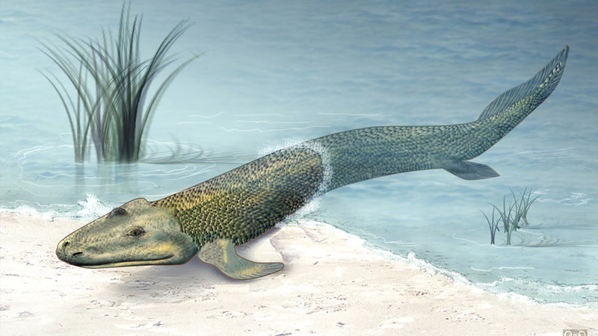
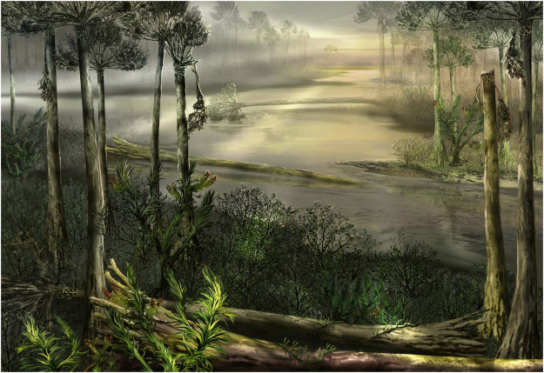
The Devonian
Key period for the evolution of
Life on Earth, with many
« game changing » biological innovations and global
ecological changes.
Klug et al. (2010)
George & Blieck (2011)
First vertebrates conquered the Land
First forests since the mid Devonian
Pawlik et al. (2020)

Slide 6
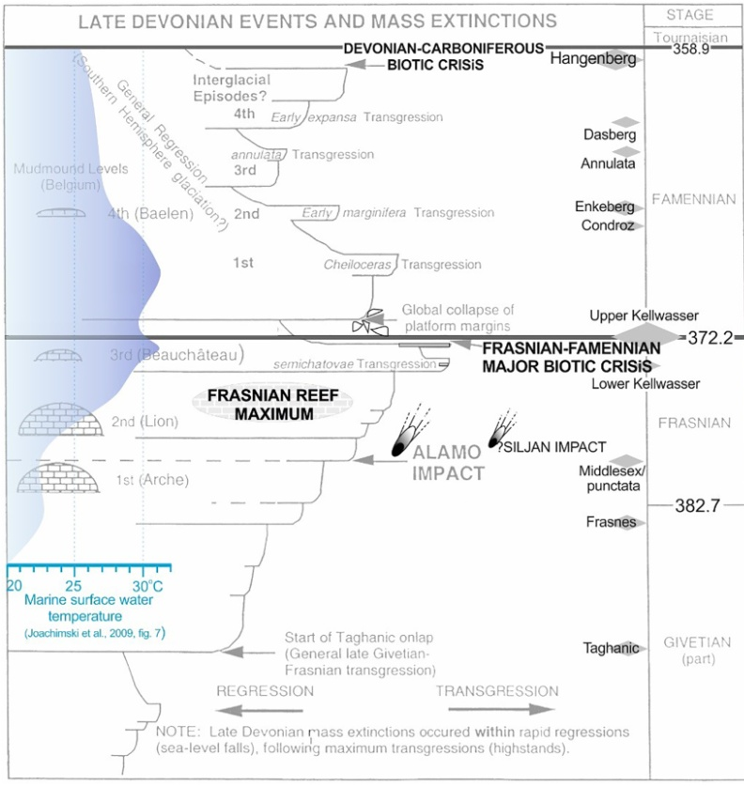
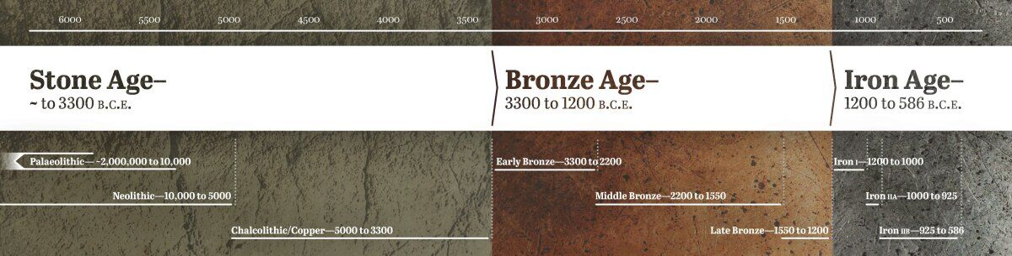
The Late Devonian Mass extinction: one of the “Big Five”
FAMENNIAN
FRASNIAN
Kellwasser mass extinction eliminated
nearly 60% of marine genera &
over 80% of species
GIVETIAN
Racki et al. (2020)

Slide 7
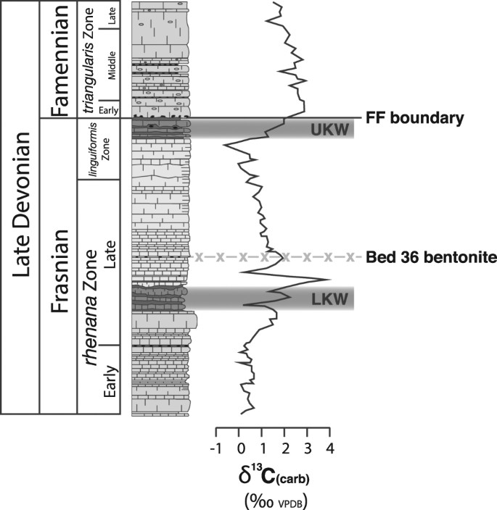
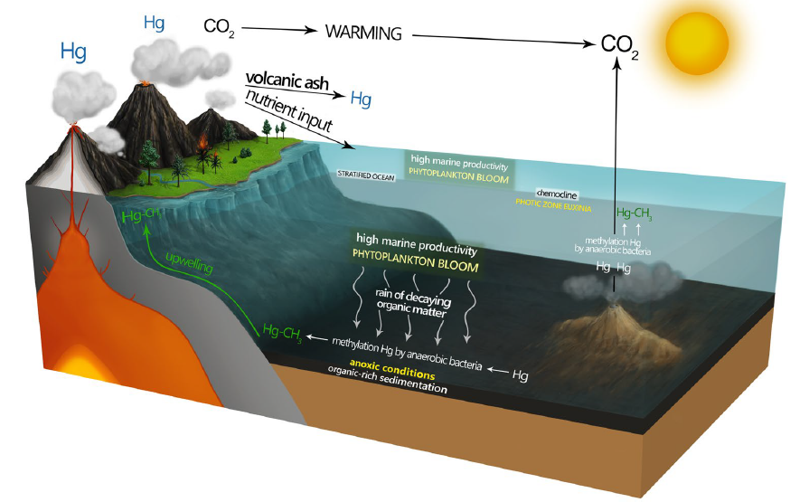
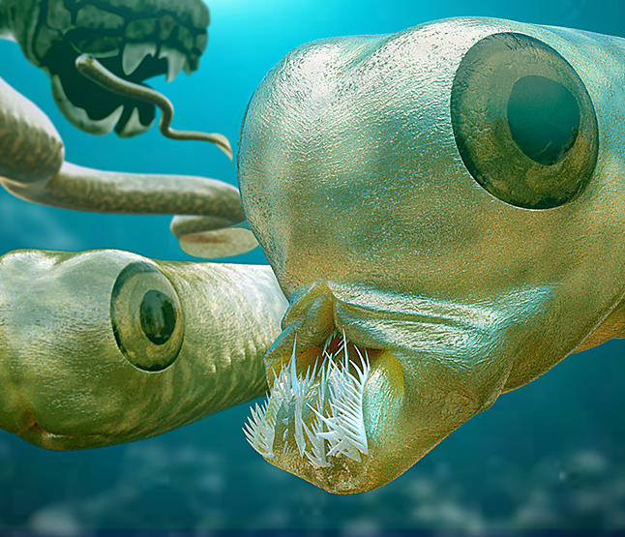
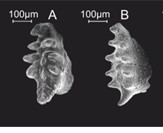
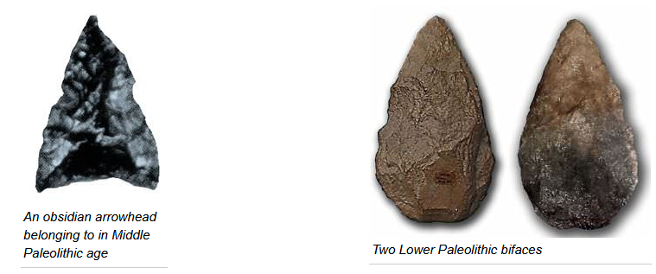
Possible Triggers and Causes of the Kellwasser Event
Massive volcanism
Climate change and widespread anoxia
372 Ma
Percival et al. (2018)
374 Ma
Conodont zones

Slide 8
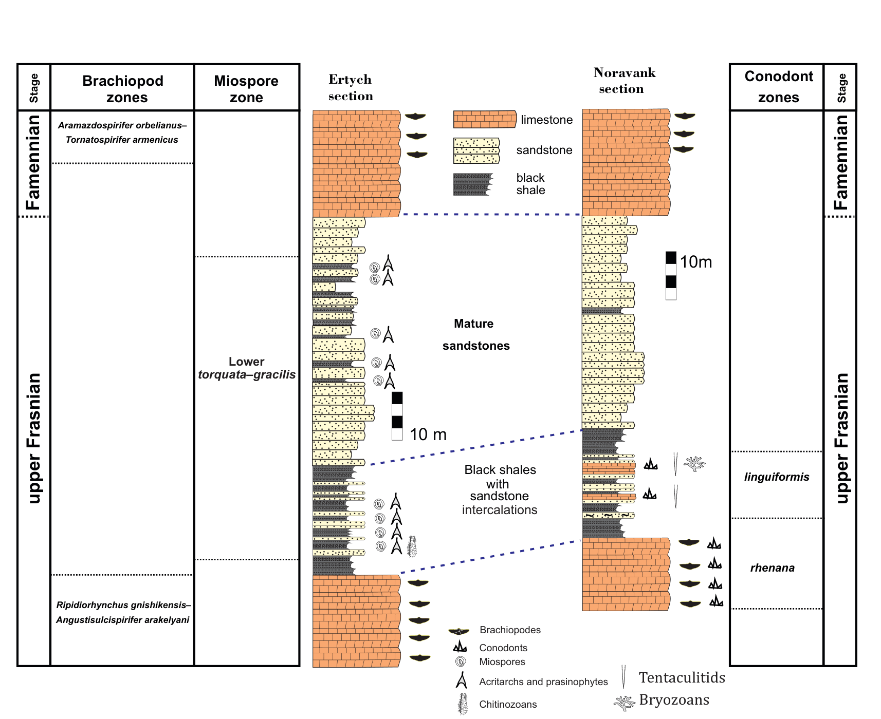
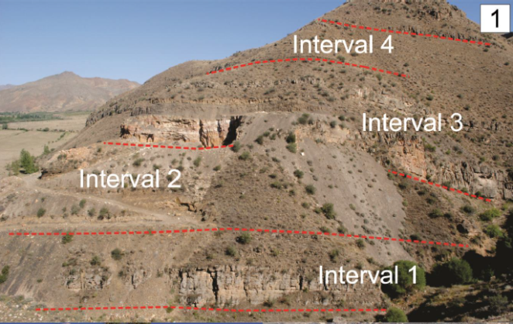
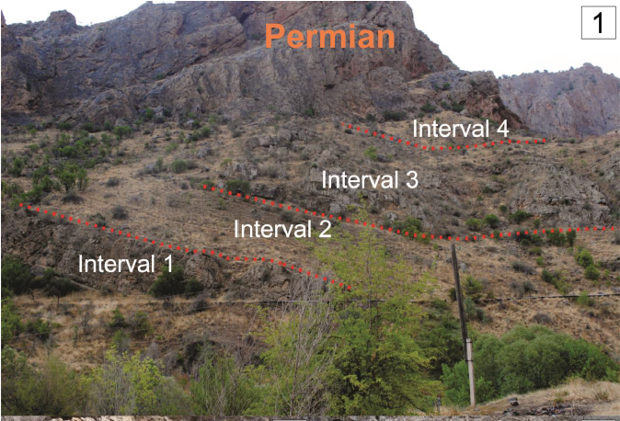
Advantages in Paleozoic Mts of Armenia
Well-exposed outcrops
Highly fossiliferous deposits
Young
Ertych section
3 interesting
localities
examined &
sampled in detail.
Noravank section
Old
Introduction
Aims
Material/methods
Global scale
North Africa
Conclusion

Slide 9
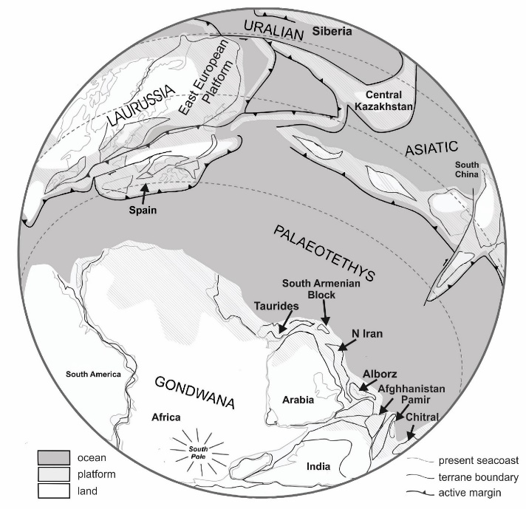
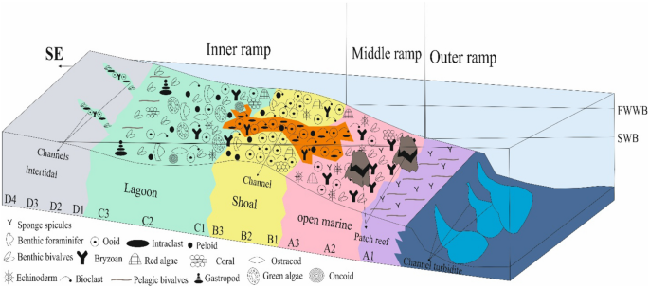
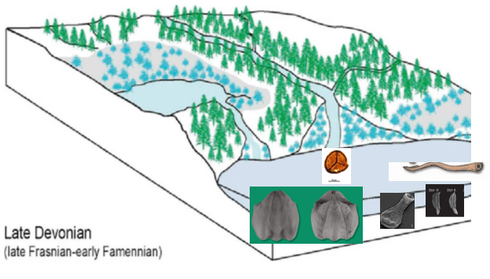
Interesting paleogeographic position
Advantages in Paleozoic Mts of Armenia
To evaluate the impact of global events in northern Gondwana
To UNRAVEL the record of the
Kellwasser extinction event &
to decipher their regional impact
on past marine and terrestrial ecosystems.
Modified after Denayer & Hoşgör, 2014)
Majority of Data come From USA, Europe, China, Russia, Kazakstan.

Slide 10
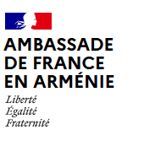

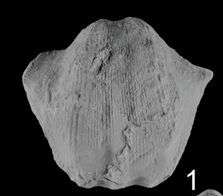
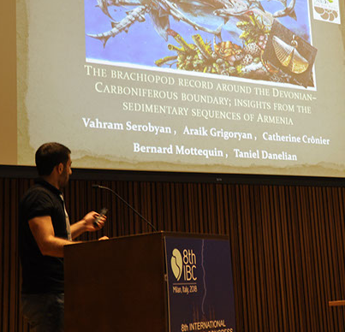
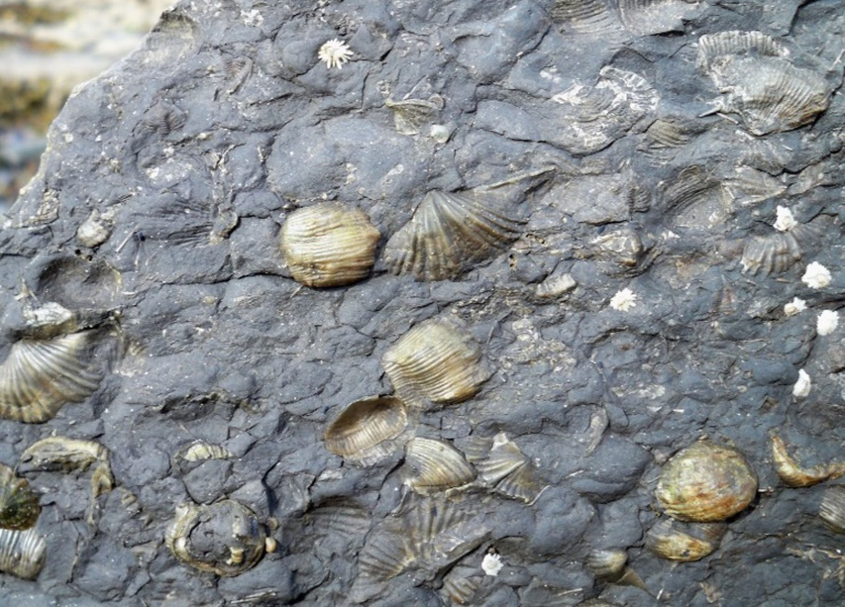
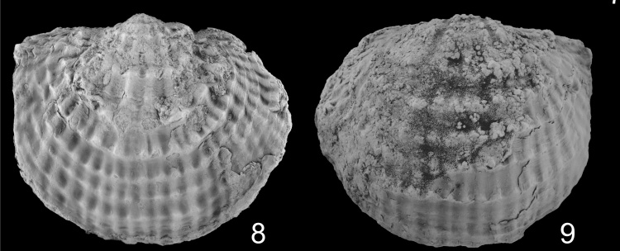
Discovery of fossil assemblages
Brachiopods. A. orbelianus
Fossil assemblages are helpful assets for dating the sections & paleoenvironmental reconstruction
Conodonts. I. iowaensis
Brachiopods. P. ertychensis
Introduction
Aims
Material/methods
North Africa
Conclusion

Slide 11
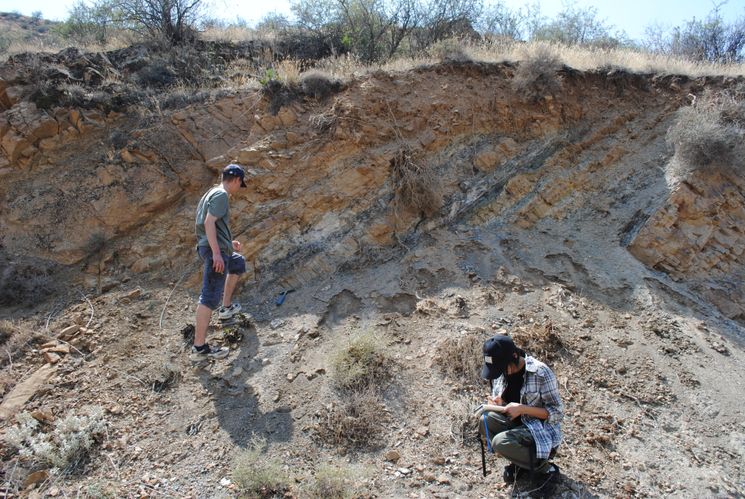
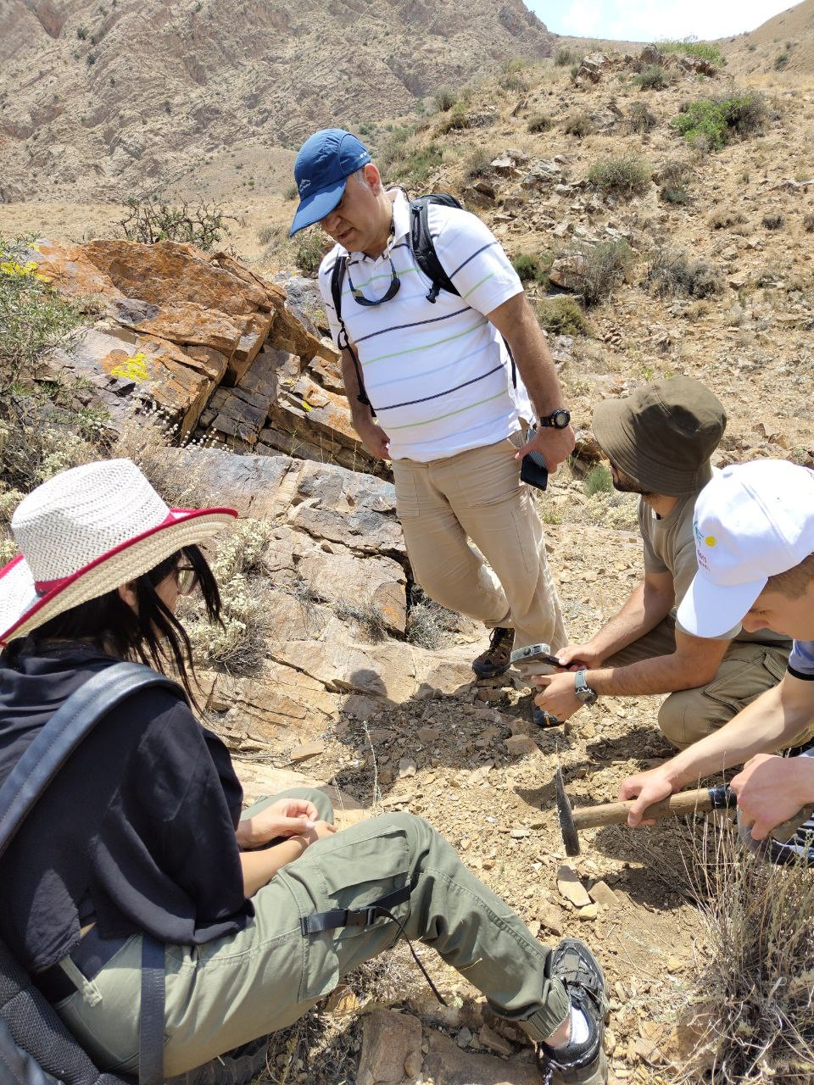
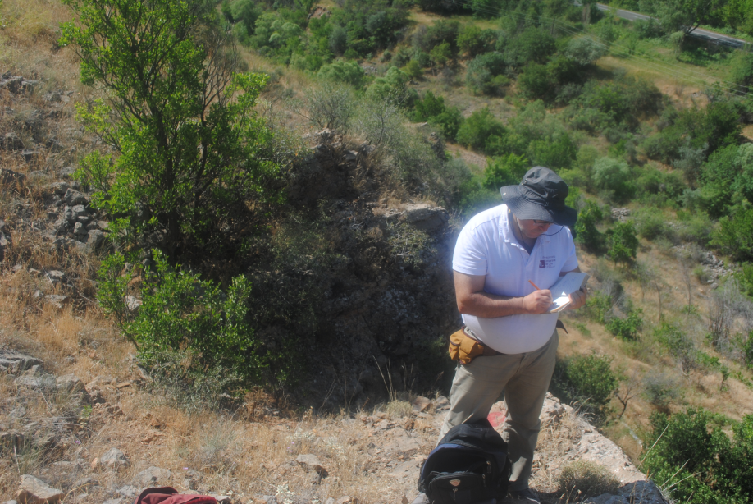
Both PI & Co-I and
young team members actively
participated in the field trips
Introduction
Aims
Material/methods
Global scale
North Africa
Conclusion

Slide 12
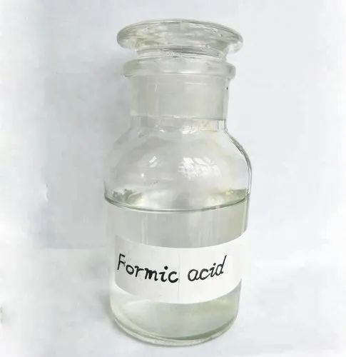
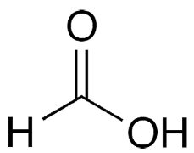
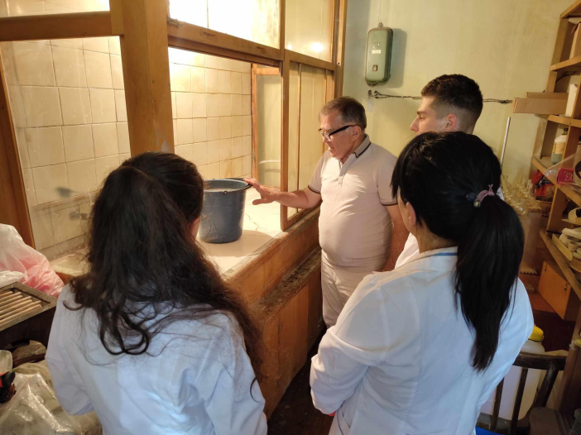
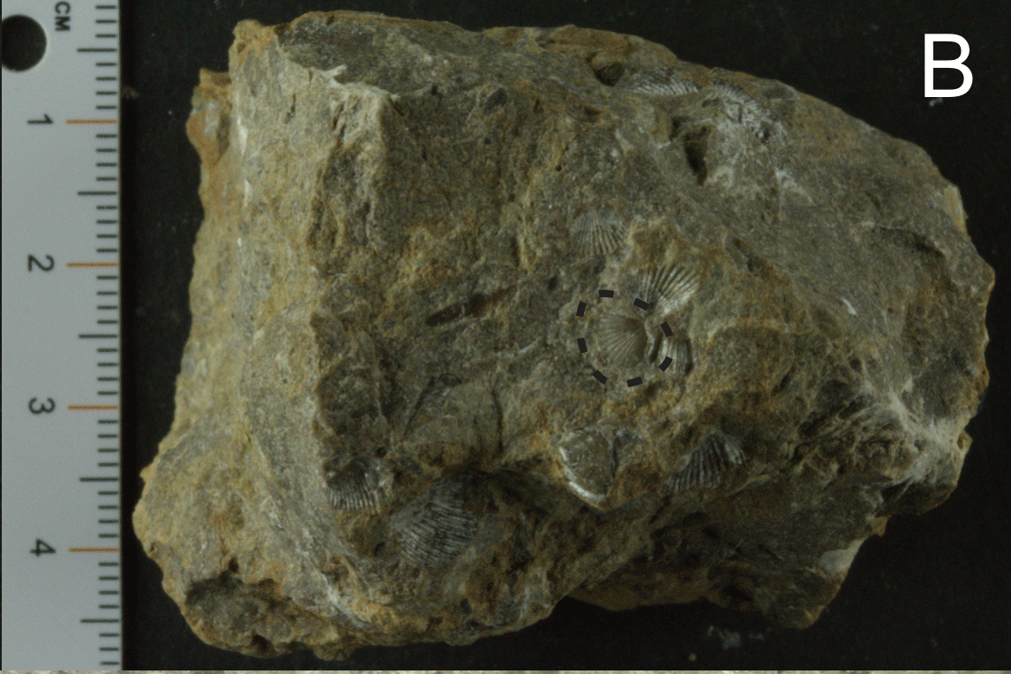

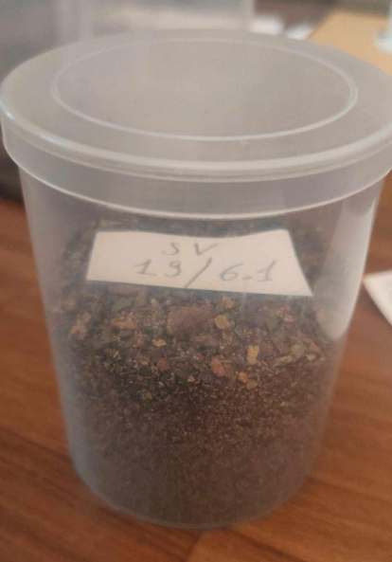
Laboratory work includes decomposition of sedimentary rocks to acquire microfauna
decomposition of
sedimentary rocks
Residue containing sand, fine-grained particles & microfauna
Processed - more than 110 samples
Introduction
Aims
Material/methods
Global scale
North Africa
Conclusion

Slide 13
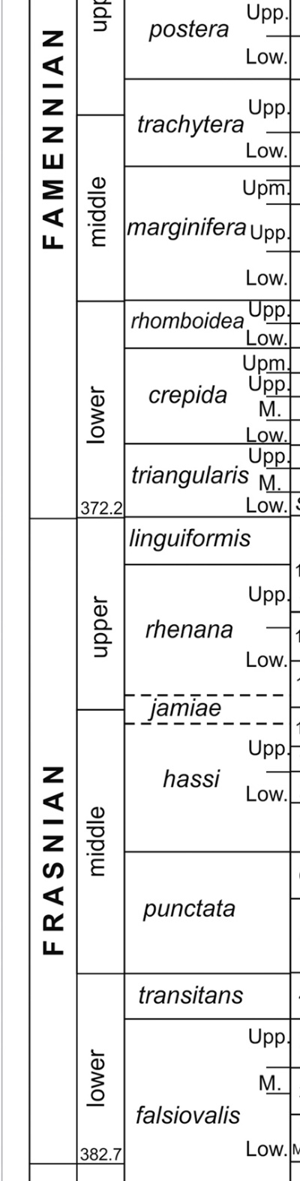

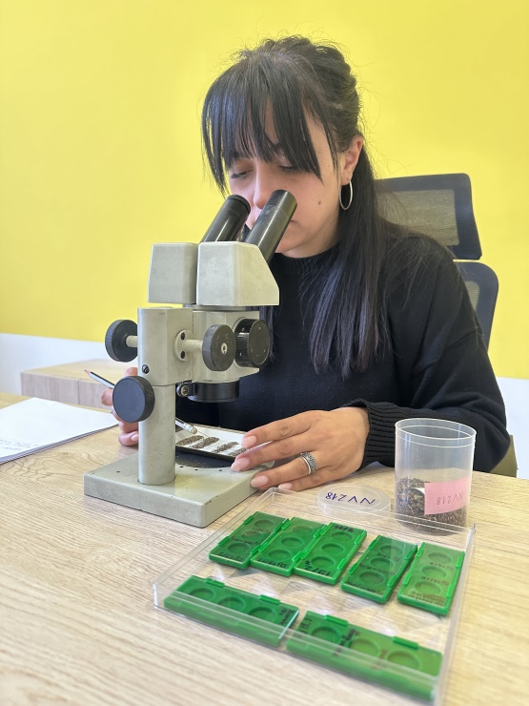
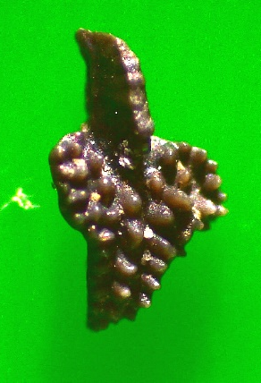


Laboratory work includes decomposition of sedimentary rocks to acquire microfauna
372 Ma
374 Ma
Picking
microfauna
Ancyrodella sp.
Gomphocythere sp.
Cladodoides sp.
Acquired - around 8000 fossil specimens
Introduction
Aims
Material/methods
Global scale
North Africa
Conclusion

Slide 14







PALEOBOTANY & PALYNOLOGY
Discovery of plant remains and of many spores,
Spores were extremelly helpful for dating the section
Ch
Teichertospora torquata
Geminospora lemurata
Acinosporites
lindlarensis
Ch
Ch
Lycopsid
Leclercqia
Xu et al. (2020)

Slide 15






Slide 16



Palaeobiogeographic implications
Marine phytoplankton assemblage from the Ertych section
The phytoplankton assemblage suggests that during the F-F critical time interval the South Armenian Block was located within warm-temperate to arid climatic belts

Slide 17



Upper Frasnian Conodont Biostratigraphy
of the Noravank section (central Armenia
Tsatryan et al. (2025)
Icriodus
iowaensis
iowaensis
Polygnathus
webbi

Slide 18



A 300 ka window of observation
Da Silva et al. (2020)
Reconstruct marine & terrestrial paleoecosystems
at northern margin of Gondwana

Slide 19


In 3.5 years: 15 published papers
mainly in Q1/Q2 journals
Journal distribution: 3 Q1, 7 Q2, 2 Q3
3 additional papers published in non-Scopus-indexed journals
3 more articles accepted for publication
2 articles are still under review
Introduction
Aims
Material/methods
Global scale
North Africa
Conclusion

Slide 20




Participation in Conferences/Congress
Serobyan V., Khachatryan S., Hairapetian V., Randon C., Steemans P., Beuer P., Mottequin B., Cascales-Miñana B., Grigoryan A., Gabrielyan I., Catherine C. Danelian T. – Frasnian-lower Famennian stratigraphy and biota in the northern Gondwana margin preserved in Armenia: 4th International Congress on Stratigraphy: Lille, France, 11th-13th July 2023.
SPEAKER
Speaker
Serobyan V., Danelian T., Grigoryan A. – The Upper Devonian sequence of the Noravank and Ertych geosites in Armenia: stratigraphy and geotouristic potential: International Conference on Stratigraphy and Geodynamics, Greece, 2025.
SPEAKER
Danelian T., Serobyan V., Gabrielyan I. – On the paleontological heritage of Armenia: insights from Upper Devonian marine sedimentary sequences and Pleistocene lacustrine diatomites: International Conference on Stratigraphy and Geodynamics, Thailand, 2025.
Danelian T., Tsatryan M., Serobyan V. – Bio-chronostratigraphy and sedimentology of the Frasnian–Famennian (Upper Devonian) transitional interval in the Armenian sector of Gondwana: International Conference on Stratigraphy and Geodynamics, Thailand, 2025.
SPEAKER
Introduction
Aims
Material/methods
Global scale
North Africa
Conclusion

Slide 21


Repair and Furnishing (one microscope room and a chemical laboratory)
Before VS After

Slide 22




Equipment procurement
2 Leica EZ4 W
Stereomicroscope
2 Leica EZ4
Stereomicroscope
1 Advanced Leica M205
Stereomicroscope
1 Leica DM 270 MP
Optical microscope

Slide 23



Successful applications (2023-25)
The Yervant Terzian Competition (2023) –
Vahram Serobyan & Sirush Khachatryan
Travel grant 2023 (to France & Belgium) –
Vahram Serobyan
Small equipment grant 2024 from Science Committee for two microscopes
Small equipment grant 2025 from Science Committee for two fume cupboards

Slide 24


Successful applications (2023-25)
The Yervant Terzian Competition (2023) – Vahram Serobyan & Sirush Khachatryan
Travel grant 2023 (to France & Belgium) – Vahram Serobyan
Small equipment grant 2024 from Science Committee for two microscops
Small equipment grant 2025 from Science Committee for two fume cupboards
Post-doc 2025 Elvis Guillam from
Supervised one master student thesis
Currently: informal supervision of two PhD students
1 submitted paper to a Q1 journal
2 papers are in preparation

Slide 25




Deciphering the global vs local signatures in the record
of the Upper Kellwasser event preserved in Armenia

Slide 26


Deciphering the global vs local signatures in the record
of the Upper Kellwasser event preserved in Armenia
Submitted grant proposal: Awaiting evaluation
International Associated Laboratory
Devonian mass extinction events and trophic chain evolution
in response to climate change (DevoTroph)

Slide 27







Conduct multidisciplinary research activities on critical Late Devonian intervals of mass extinction events in Armenia
Fostering Earth System Science In Armenia

Slide 28


Thank you for your attention
Omegops armeniensis sp. nov
Crônier et al. in press
A newly discovered trilobite species from the Ararat region, named in honor of Armenia

